Slide 1

Mobile Development of Philippine Rainfall Outlook Through Data Driven Documents and Web-View Applications
Adrienne Elise R Cortez

Slide 2
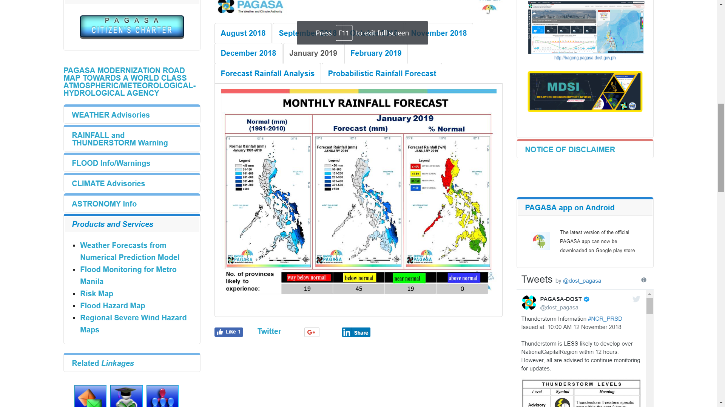
PAG ASA

Slide 3
Objective
Provide a mobile application for the Rainfall Outlook of the next six months based on the look and feel of the same app in the SARAi website.

Slide 4
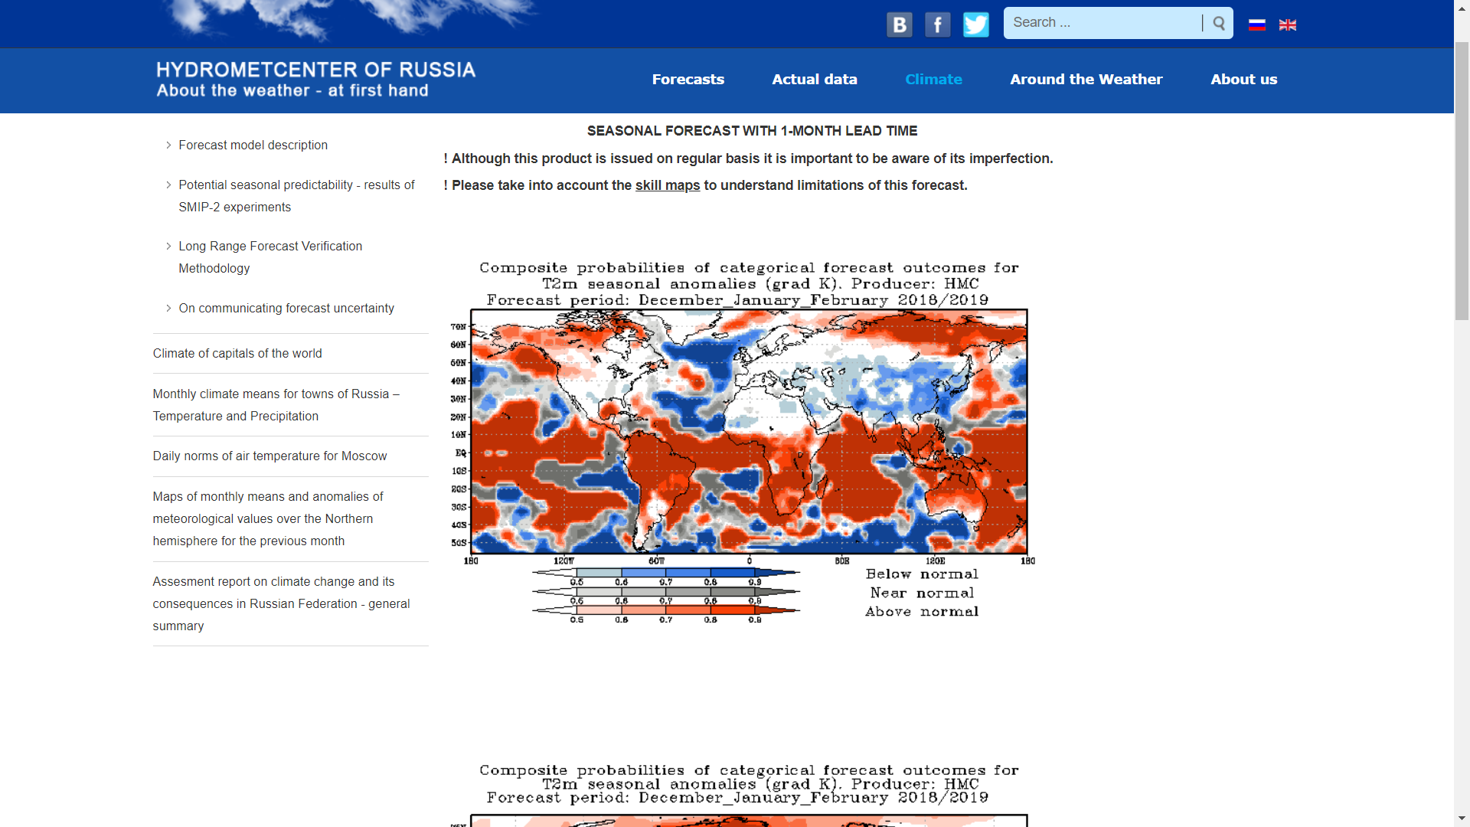
Russia Hydrometcenter

Slide 5
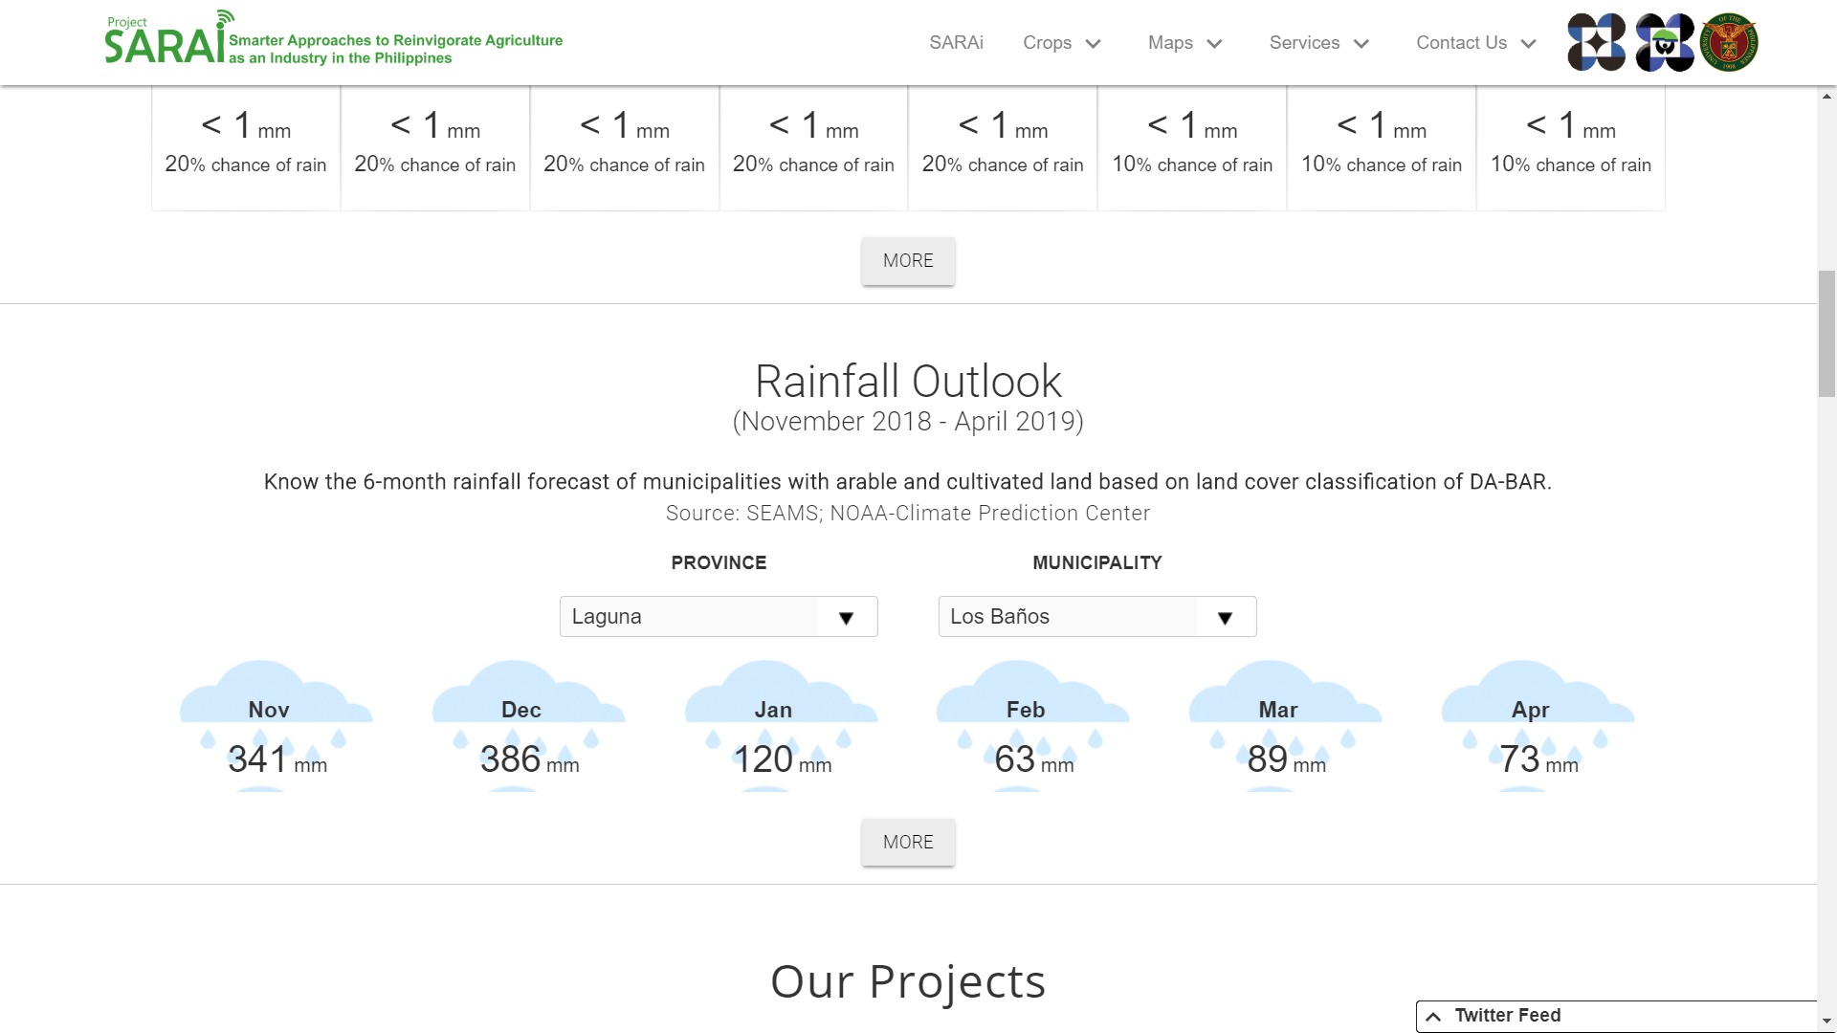

Slide 6
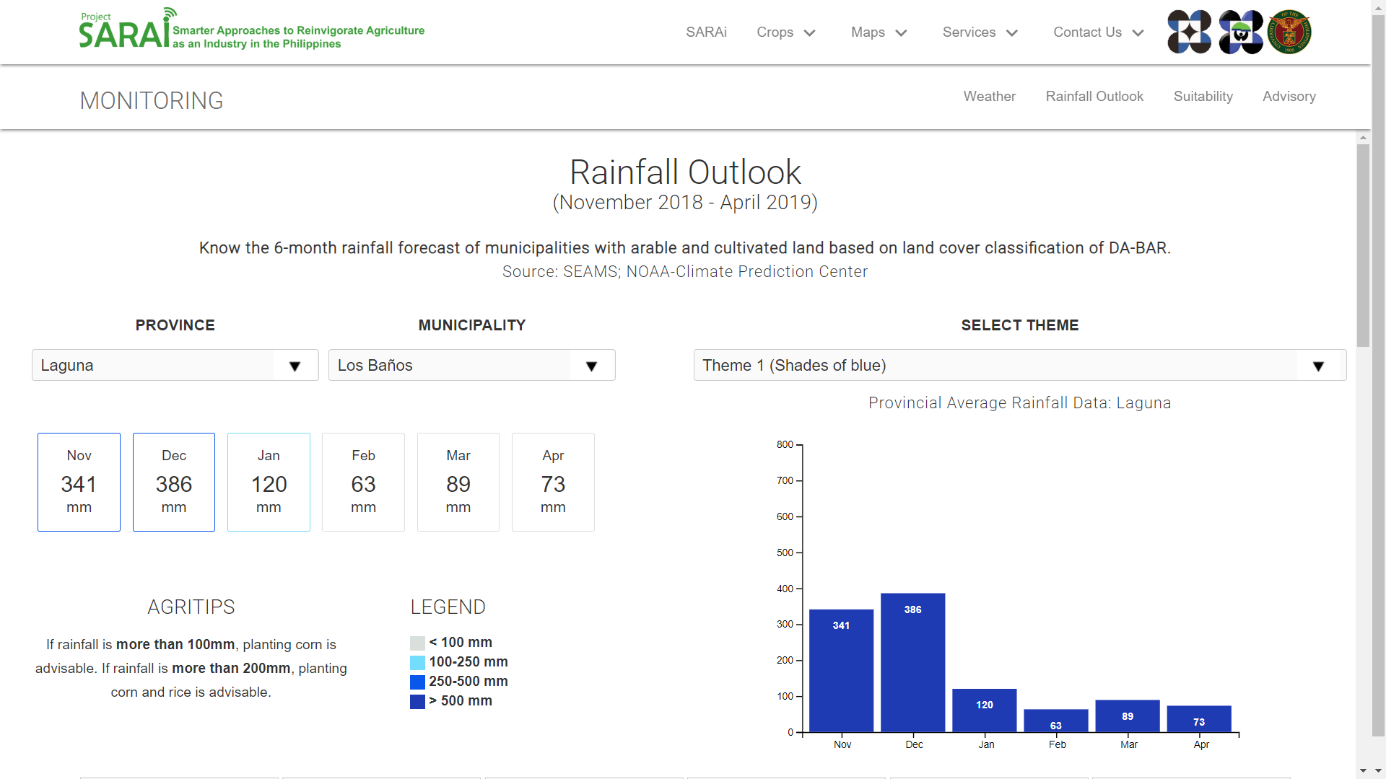

Slide 7
Technologies Used
PhoneGap, HTML, CSS, JavaScript, D3JS, Apache Cordova,
Notes:
GIS comparison.

Slide 8
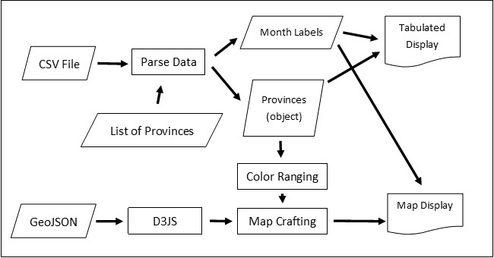

Slide 9
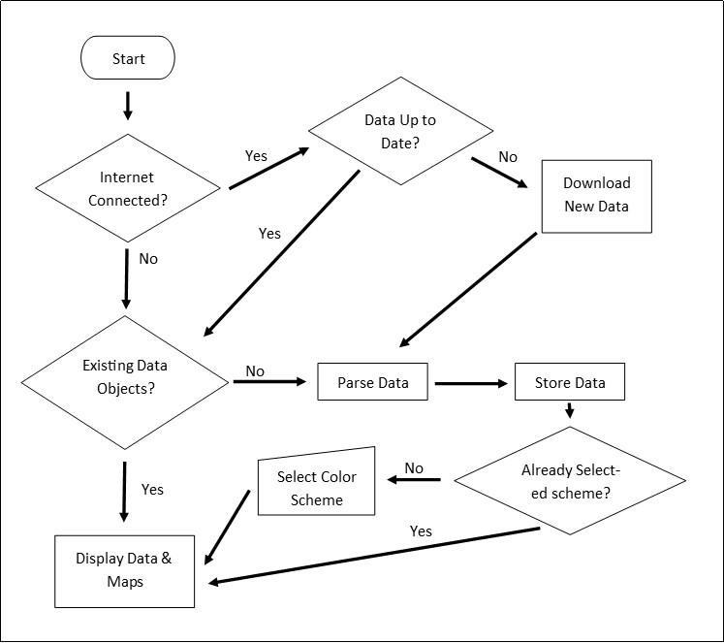

Notes:
Current state of things. Size of app is around 6 to 7 MB depending on the current build.

